Slide 1
CPE 445-Internet of Things
Dr. Abbas Javed
Assistant Professor
Department of Electrical and Computer Engineering,
COMSATS University Islamabad, Lahore Campus
abbasjaved@cuilahore.edu.pk

Slide 2
Connecting Smart Objects
Communication Criteria: The characteristics and attributes you should consider when selecting and dealing with connecting smart objects
IoT Access Technologies: provides an in-depth look at some of the technologies that are considered when connecting smart objects

Slide 3
Communication Criteria
Range: This section examines the importance of signal propagation and distance.
Frequency Bands: This section describes licensed and unlicensed spectrum, including sub-GHz frequencies.
Power Consumption: This section discusses the considerations required for devices connected to a stable power source compared to those that are battery powered.
Topology: This section highlights the various layouts that may be supported for connecting multiple smart objects.
Constrained Devices: This section details the limitations of certain smart objects from a connectivity perspective.
Constrained-Node Networks: This section highlights the challenges that are often encountered with networks connecting smart objects.

Slide 4
IoT Access Technologies
IEEE 802.15.4: This section highlights IEEE 802.15.4, an older but foundational wireless protocol for connecting smart objects.
IEEE 802.15.4g and IEEE 802.15.4e: This section discusses improvements to 802.15.4 that are targeted to utilities and smart cities deployments.
IEEE 1901.2a: This section discusses IEEE 1901.2a, which is a technology for connecting smart objects over power lines.
IEEE 802.11ah: This section discusses IEEE 802.11ah, a technology built on the well-known 802.11 Wi-Fi standards that is specifically for smart objects.
LoRaWAN: This section discusses LoRaWAN, a scalable technology designed for longer distances with low power requirements in the unlicensed spectrum.
NB-IoT and Other LTE Variations: This section discusses NB-IoT and other LTE variations, which are often the choice of mobile service providers looking to connect smart objects over longer distances in the licensed spectrum.

Slide 5
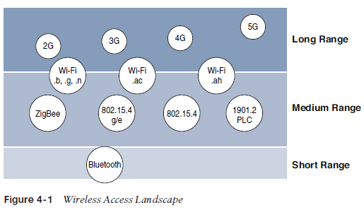
Communications Criteria
Range
How far does the signal need to be propagated?
Area of coverage for a selected wireless technology?
Should indoor vs outdoor deployments be differentiated?
Simplest answer is to categorize these technologies as shown in Figure 4.1

Slide 6
Communication Criteria-Range
Short range: The classical wired example is a serial cable. Wireless short-range technologies are often considered as an alternative to a serial cable, supporting tens of meters of maximum distance between two devices. Examples of short-range wireless technologies are IEEE 802.15.1 Bluetooth and IEEE 802.15.7 Visible Light Communications (VLC).
Medium range: This range is the main category of IoT access technologies. In the range of tens to hundreds of meters, many specifications and implementations are available. The maximum distance is generally less than 1 mile between two devices, although RF technologies do not have real maximum distances defined, as long as the radio signal is transmitted and received in the scope of the applicable specification. Examples of medium-range wireless technologies include IEEE 802.11 Wi-Fi, IEEE 802.15.4, and 802.15.4g WPAN. Wired technologies such as IEEE 802.3 Ethernet and IEEE 1901.2 Narrowband Power Line Communications (PLC) may also be classified as medium range, depending on their physical media characteristics.

Slide 7
Communication Criteria-Range
Long range: Distances greater than 1 mile between two devices require long-range technologies. Wireless examples are cellular (2G, 3G, 4G) and some applications of outdoor IEEE 802.11 Wi-Fi and Low-Power Wide-Area (LPWA) technologies. LPWA communications have the ability to communicate over a large area without consuming much power. These technologies are therefore ideal for battery-powered IoT sensors. Found mainly in industrial networks, IEEE 802.3 over optical fiber and IEEE 1901 Broadband Power Line Communications are classified as long range

Slide 8
Communication Criteria- Frequency Bands
The frequency bands leveraged by wireless communications are split between licensed and unlicensed bands
Licensed spectrum is generally applicable to IoT long-range access technologies and allocated to communications infrastructures deployed by services providers, public services (for example, first responders, military), broadcasters, and utilities.
In licensed spectrum, users must subscribe to services when connecting their IoT devices
In exchange for the subscription fee, the network operator can guarantee the exclusivity of the frequency usage over the target area and can therefore sell a better guarantee of service
Examples of licensed spectrum commonly used for IoT access are cellular, WiMAX, and Narrowband IoT (NB-IoT) technologies

Slide 9
Communication Criteria- Frequency Bands
International Telecommunication Union (ITU) has also defined unlicensed spectrum for the industrial, scientific, and medical (ISM) portions of the radio bands
Unlicensed means that no guarantees or protections are offered in the ISM bands for device communications. For IoT access, these are the most well-known ISM bands:
2.4 GHz band as used by IEEE 802.11b/g/n Wi-Fi
IEEE 802.15.1 Bluetooth
IEEE 802.15.4 WPAN
National and regional regulations exists for unlicensed frequency bands. These regulations mandate device compliance on parameters such as transmit power, duty cycle and dwell time, channel bandwidth, and channel hopping
Licensed or unlicensed? LPWA communications are able to cover long distances that in the past required the licensed bands offered by service providers for cellular devices
Sub-GHz bands are used by protocols such as IEEE 802.15.4, 802.15.4g, and 802.11ah, and LPWA technologies such as LoRa and Sigfox.
Sub-GHz frequency bands allow greater distance. These bands have a greater ability than the 2.4 GHZ ISM band to penetrate building infrastructures.

Slide 10
Communication Criteria- Frequency Bands
Disadvantage of sub-GHz frequency bands is lower data rate
In most European countries, the 169 MHz band is often considered best suited for wireless water and gas metering applications. This is due to its good deep building basement signal penetration.
Several sub-GHz ranges have been defined in the ISM band. The most well-known ranges are centered on 169 MHz, 433 MHz, 868 MHz, and 915 MHz.
Note Countries may also specify other unlicensed bands. For example, China has provisioned the 779–787 MHz spectrum as documented in the LoRaWAN 1.0 specifications and IEEE 802.15.4g standard.

Slide 11
Communication Criteria- Frequency Bands
European Conference of Postal and Telecommunications Administrations (CEPT), in the European Radiocommunications Committee (ERC) Recommendation 70-03, defines the 868 MHz frequency band
European countries generally apply Recommendation 70-03 to their national telecommunications regulations, but the 868 MHz definition is also applicable to regions and countries outside Europe. Examples: India, Middle East, Africa and Russia
Recommendation 70-03 mostly characterizes the use of the 863–870 MHz band, the allowed transmit power, or EIRP (effective isotropic radiated power), and duty cycle (that is, the percentage of time a device can be active in transmission)
EIRP is the amount of power that an antenna would emit to produce the peak power density observed in the direction of maximum antenna gain
Centered on 915 MHz, the 902–928 MHz frequency band is the main unlicensed sub-GHz band available in North America, Australia and Japan

Slide 12
Communication Criteria- Power Consumption
IoT wireless access technologies must address the needs of low power consumption and connectivity for battery-powered nodes
This has led to the evolution of a new wireless environment known as Low-Power Wide-Area (LPWA)
Wired IoT access technologies consisting of powered nodes are not exempt from power optimization
Smart meter over PLC can’t consume 5 to 10 watts of power. For 20 million meters deployment, 100 to 200 megawatts of energy will be consumed.

Slide 13
Communication Criteria- Topology
three main topology schemes are dominant: star, mesh, and peer-to-peer
For long-range and short-range technologies, a star topology is prevalent, as seen with cellular, LPWA, and Bluetooth networks
Star topologies utilize a single central base station or controller to allow communications with endpoints.
For medium-range technologies, a star, peer-to-peer, or mesh topology is common, as shown in Figure 4-2
Peer-to-peer topologies allow any device to communicate with any other device as long as they are in range of each other

Slide 14
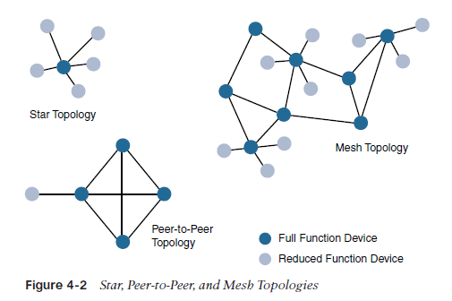
For example, indoor Wi-Fi deployments are mostly a set of nodes forming a star topology around their access points (APs). Meanwhile, outdoor Wi-Fi may consist of a mesh topology for the backbone of APs, with nodes connecting to the APs in a star topology. Similarly, IEEE 802.15.4 and 802.15.4g and even wired IEEE 1901.2a PLC are generally deployed as a mesh topology. A mesh topology helps cope with low transmit power, searching to reach a greater overall distance, and coverage by having intermediate nodes relaying traffic for other nodes.

Slide 15
Communication Criteria- Topology
Mesh topology requires a properly optimized implementation for battery-powered nodes
Battery-powered nodes are often placed in a “sleep mode” to preserve battery life when not transmitting
In the case of mesh topology, either the battery-powered nodes act as leaf nodes or as a “last resource path” to relay traffic when used as intermediate nodes

Slide 16
Communication Criteria- Constrained Devices
Class 0: This class of nodes is severely constrained, with less than 10 KB of memory and less than 100 KB of Flash processing and storage capability. These nodes are typically battery powered. They do not have the resources required to directly implement an IP stack and associated security mechanisms. An example of a Class 0 node is a push button that sends 1 byte of information when changing its status. This class is particularly well suited to leveraging new unlicensed LPWA wireless technology.

Slide 17
Communication Criteria- Constrained Devices
Class 1: While greater than Class 0, the processing and code space characteristics (approximately 10 KB RAM and approximately 100 KB Flash) of Class 1 are still lower than expected for a complete IP stack implementation. They cannot easily communicate with nodes employing a full IP stack. However, these nodes can implement an optimized stack specifically designed for constrained nodes, such as Constrained Application Protocol (CoAP). This allows Class 1 nodes to engage in meaningful conversations with the network without the help of a gateway and provides support for the necessary security functions. Environmental sensors are an example of Class 1 nodes

Slide 18
Communication Criteria- Constrained Devices
Class 2 nodes are characterized by running full implementations of an IP stack on embedded devices. They contain more than 50 KB of memory and 250 KB of Flash, so they can be fully integrated in IP networks. A smart power meter is an example of a Class 2 node.

Slide 19
Communication Criteria- Constrained-Node Networks
IEEE 802.15.4 and 802.15.4g RF, IEEE 1901.2a PLC, LPWA, and IEEE 802.11ah access technologies are suitable to connect constrained devices.
Constrained-node networks are often referred to as low-power and lossy networks (LLNs)
Low-power in the context of LLNs refers to the fact that nodes must cope with the requirements from powered and battery powered constrained nodes
Lossy networks indicates that network performance may suffer from interference and variability due to harsh radio environments
Layer 1 and Layer 2 protocols that can be used for constrained-node networks must be evaluated in the context of the following characteristics for use-case applicability: data rate and throughput, latency and determinism, and overhead and payload

Slide 20
Communication Criteria- Constrained-Node Networks
Data rate and Throughput
The data rates available from IoT access technologies range from 100 bps with protocols such as Sigfox to tens of megabits per second with technologies such as LTE and IEEE 802.11ac. However, the actual throughput is less—sometimes much less—than the data rate
Cellular and Wi-Fi, match up well to IoT applications with high bandwidth requirements
Real throughput is often very important for constrained devices implementing an IP stack.
Throughput is a lower percentage of the data rate, even if the node gets the full constrained network at a given time
Majority of IoT devices initiate the communication. Upstream traffic toward an application server is usually more common than downstream traffic from the application server.

Slide 21
Communication Criteria- Constrained-Node Networks
Latency and Determinism
Much like throughput requirements, latency expectations of IoT applications should beknown when selecting an access technology
This is particularly true for wireless networks, where packet loss and retransmissions due to interference, collisions, and noise are normal behaviors.
On constrained networks, latency may range from a few milliseconds to seconds, and applications and protocol stacks must cope with these wide-ranging values
For example, UDP (user datagram protocol) at the transport layer is strongly recommended for IP endpoints communicating over LLNs. In the case of mesh topologies, if communications are needed between two devices inside the mesh, the forwarding path may call for some routing optimization, which is available using the IPv6 RPL protocol.

Slide 22
Communication Criteria- Constrained-Node Networks
Overhead and Payload
When considering constrained access network technologies, it is important to review the MAC payload size characteristics required by applications
Most LPWA technologies offer small payload sizes
These small payload sizes are defined to cope with the low data rate and time over the air or duty cycle requirements of IoT nodes and sensors.
For example, payloads may be as little as 19 bytes using LoRaWAN technology or up to 250 bytes, depending on the adaptive data rate (ADR).

Slide 23
IoT Access Technologies
Standardization and alliances: The standards bodies that maintain the protocols for a technology
Physical layer: The wired or wireless methods and relevant frequencies
MAC layer: Considerations at the Media Access Control (MAC) layer, which bridges the physical layer with data link control
Topology: The topologies supported by the technology
Security: Security aspects of the technology
Competitive technologies: Other technologies that are similar and may be suitable alternatives to the given technology

Slide 24
IEEE 802.15.4
IEEE 802.15.4 is a wireless access technology for low-cost and low-data-rate devices that are powered or run on batteries
This access technology enables easy installation using a compact protocol stack while remaining both simple and flexible.
IEEE 802.15.4 is commonly found in the following types of deployments:
Home and building automation
Automotive networks
Industrial wireless sensor networks
Interactive toys and remote controls

Slide 25
IEEE 802.15.4
Criticisms of IEEE 802.15.4 often focus on its MAC reliability, unbounded latency, and susceptibility to interference and multipath fading
The negatives around reliability and latency often have to do with the Collision Sense Multiple Access/Collision Avoidance (CSMA/CA) algorithm
CSMA/CA is an access method in which a device “listens” to make sure no other devices are transmitting before starting its own transmission. If another device is transmitting, a wait time (which is usually random) occurs before “listening” occurs again
Interference and multipath fading occur with IEEE 802.15.4 because it lacks a frequency-hopping technique

Slide 26
Protocol Stacks Utilizing IEEE 802.15.4
ZigBee Promoted through the ZigBee Alliance, ZigBee defines upper-layer components (network through application) as well as application profiles. Common profiles include building automation, home automation, and healthcare. ZigBee also defines device object functions, such as device role, device discovery, network join, and security
6LoWPAN is an IPv6 adaptation layer defined by the IETF 6LoWPAN working group that describes how to transport IPv6 packets over IEEE 802.15.4 layers. RFCs document header compression and IPv6 enhancements to cope with the specific details of IEEE 802.15.4

Slide 27
Protocol Stacks Utilizing IEEE 802.15.4
ISA100.11a is developed by the International Society of Automation (ISA) as “Wireless Systems for Industrial Automation: Process Control and Related Applications.” It is based on IEEE 802.15.4-2006, and specifications were published in 2010 and then as IEC 62734. The network and transport layers are based on IETF 6LoWPAN, IPv6, and UDP standards.
WirelessHART, promoted by the HART (highway addressable remote transducer) Communication Foundation, is a protocol stack that offers a time-synchronized, self-organizing, and self-healing mesh architecture, leveraging IEEE 802.15.4-2006 over the 2.4 GHz frequency band.
Constructed on top of IETF 6LoWPAN/IPv6, Thread is a protocol stack for a secure and reliable mesh network to connect and control products in the home

Slide 28
ZigBee
The first ZigBee specification was ratified in 2004
Zigbee Alliance is an industry group formed to certify interoperability between vendors and it is committed to driving and evolving ZigBee as an IoT solution for interconnecting smart objects
More than 400 companies that are members of the ZigBee Alliance
ZigBee solutions are aimed at smart objects and sensors that have low bandwidth and low power needs
For home automation, ZigBee can control lighting, thermostats, and security functions
The ZigBee network and security layer provides mechanisms for network startup, configuration, routing, and securing communications. Calculating routing paths in what is often a changing topology, discovering neighbors, and managing the routing tables as devices join for the first time
Network layer is responsible for forming the appropriate topology, mesh, tree, star.
ZigBee utilizes 802.15.4 for security at the MAC layer, using the Advanced Encryption Standard (AES) with a 128-bit key and also provides security at the network and application layer

Slide 29
ZigBee uses Ad hoc On-Demand Distance Vector (AODV) routing across a mesh network. Interestingly, this routing algorithm does not send a message until a route is needed. Assuming that the next hop for a route is not in its routing table, a network node broadcasts a request for a routing connection. This causes a burst of routing-related traffic, but after a comparison of various responses, the path with the lowest number of hops is determined for the connection. This process is quite different from standard enterprise routing protocols, which usually learn the entire network topology in some manner and then store a consolidated but complete routing table.

Slide 30
ZigBee IP
With the introduction of ZigBee IP, the support of IEEE 802.15.4 continues, but the IP and TCP/UDP protocols and various other open standards are now supported at the network and transport layers
ZigBee IP was created to embrace the open standards coming from the IETF’s work on LLNs, such as IPv6, 6LoWPAN, and RPL
ZigBee IP is a critical part of the Smart Energy (SE) Profile 2.0 specification from the ZigBee Alliance. SE 2.0 is aimed at smart metering and residential energy management systems
Unlike traditional ZigBee, discussed in the previous section, ZigBee IP supports 6LoWPAN as an adaptation layer
The 6LoWPAN mesh addressing header is not required as ZigBee IP utilizes the mesh-over or route-over method for forwarding packets.

Slide 31
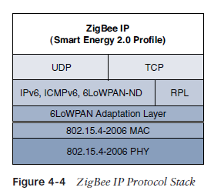
ZigBee IP

Slide 32
ZigBee IP
At the network layer, all ZigBee IP nodes support IPv6, ICMPv6, and 6LoWPAN Neighbor Discovery (ND), and utilize RPL for the routing of packets across the mesh network.
TCP and UDP are also supported, to provide both connection-oriented and connectionless service.
ZigBee IP is based on current IoT standards at every layer under the application layer.
ZigBee IP can integrate and interoperate on just about any 802.15.4 network

Slide 33
Physical Layer
The 802.15.4 standard supports an extensive number of PHY options that range from 2.4 GHz to sub-GHz frequencies in ISM bands
The original IEEE 802.15.4-2003 standard specified only three PHY options based on direct sequence spread spectrum (DSSS)modulation
DSSS is a modulation technique in which a signal is intentionally spread in the frequency domain, resulting in greater bandwidth
The original physical layer transmission options were as follows:
2.4 GHz, 16 channels, with a data rate of 250 kbps
915 MHz, 10 channels, with a data rate of 40 kbps
868 MHz, 1 channel, with a data rate of 20 kbps

Slide 34
IEEE 802.15.4-2006, 802.15.4-2011, and IEEE 802.15.4-2015 introduced additional PHY communication options, including the following:
OQPSK PHY: This is DSSS PHY, employing offset quadrature phase-shift keying (OQPSK) modulation. OQPSK is a modulation technique that uses four unique bit values that are signaled by phase changes. An offset function that is present during phase shifts allows data to be transmitted more reliably.
BPSK PHY: This is DSSS PHY, employing binary phase-shift keying (BPSK) modulation. BPSK specifies two unique phase shifts as its data encoding scheme.
ASK PHY: This is parallel sequence spread spectrum (PSSS) PHY, employing amplitude shift keying (ASK) and BPSK modulation. PSSS is an advanced encoding scheme that offers increased range, throughput, data rates, and signal integrity compared to DSSS. ASK uses amplitude shifts instead of phase shifts to signal different bit values.
These improvements increase the maximum data rate for both 868 MHz and 915 MHz to 100 kbps and 250 kbps, respectively

Slide 35
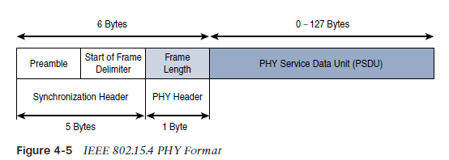
Figure 4-5 shows the frame for the 802.15.4 physical layer. The synchronization header for this frame is composed of the Preamble and the Start of Frame Delimiter fields. The Preamble field is a 32-bit 4-byte (for parallel construction) pattern that identifies the start of the frame and is used to synchronize the data transmission
The Start of Frame Delimiter field informs the receiver that frame contents start immediately after this byte.
The PHY Header portion of the PHY frame shown in Figure 4-5 is simply a frame length value. It lets the receiver know how much total data to expect in the PHY service data unit (PSDU) portion of the 802.4.15 PHY. The PSDU is the data field or payload.

Slide 36
MAC Layer
IEEE 802.15.4 MAC layer manages access to the PHY channel by defining how devices in the same area will share the frequencies allocated
The scheduling and routing of data frames are also coordinated
Network beaconing for devices acting as coordinators (New devices use beacons to join an 802.15.4 network)
PAN association and disassociation by a device
Device security
Reliable link communications between two peer MAC entities
The MAC layer achieves these tasks by using various predefined frame types. In fact, four types of MAC frames are specified in 802.15.4:
Data frame: Handles all transfers of data
Beacon frame: Used in the transmission of beacons from a PAN coordinator
Acknowledgement frame: Confirms the successful reception of a frame
MAC command frame: Responsible for control communication between devices

Slide 37
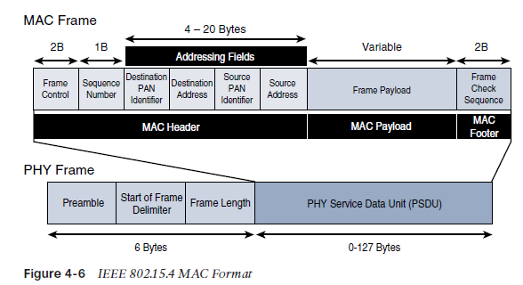

Slide 38
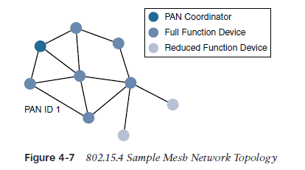
Topology
802.15.4 PAN should be set up with a unique ID.
Full-function devices (FFDs) and reduced-function devices (RFDs) are defined in IEEE 802.15.4.
A minimum of one FFD acting as a PAN coordinator is required to deliver services that allow other devices to associate and form a cell or PAN
FFD devices can communicate with any other devices, whereas RFD devices can communicate only with FFD devices

Slide 39
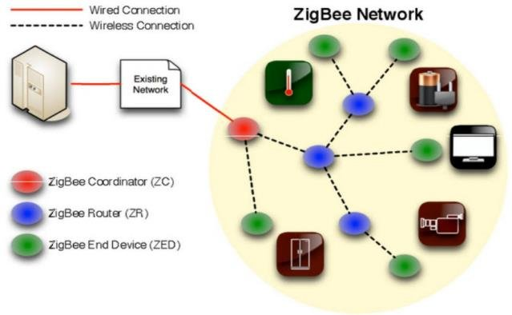
Zigbee Network Architecture

Slide 40
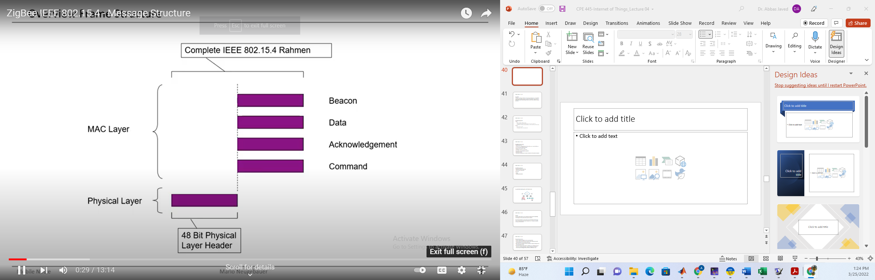

Slide 41
IEEE 802.15.4
6LowPAN
IPv6 over Low-Power Wireless Personal Area Networks is a networking technology or adaption layer that allows IPv6 packets to be carried effectively within small link layer frames, such as those defined by IEEE 802.15.4

Slide 42
IEEE 802.15.4
6LoWPAN: Why IPv6?
Pros
More suitable for higher density
No Network Address Translation (NAT) necessary (less expensive)
Possibility of adding innovating techniques such as location aware addressing
Cons
Large address width
Complying to IPv6 node requirements

Slide 43
IEEE 802.15.4
6LoWPAN Characteristics
Small packet size
16-bit short or IEEE 64-bit extended media access control addresses
Low bandwidth (250/40/20 kbps)
Range between 10m to 30m
Topologies include star and mesh
Low power, typically battery operated
Relatively low cost
Inherently unreliable due to nature of devices in the wireless medium

Slide 44
IEEE 802.15.4
6LoWPAN applications
Equipment health monitoring
Environment monitoring
Security
Home
Building Automation

Slide 45
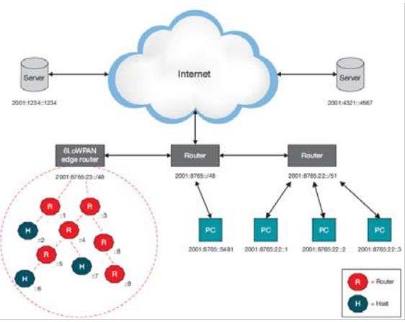
6LoWPAN Network Architecture

Slide 46
IEEE 802.15.4
Thread
Thread is a low power, secure and internet-based mesh networking technology for home and commercial IoT products
The thread standard is a stack built on top of IEEE 802.15.4 PHY and MAC. The thread stack has built in features for IP routing, 6LoWPAN, security and commission.

Slide 47
IEEE 802.15.4
Thread Characteristics
Simple network installation, start-up and operation
Secure: Devices do not join the network unless authorized and all communications are encrypted and secure.
Data rate up to 250 Kbits/s and can support as many as 250 devices in one local network mesh
The thread domain model allows scalability up to 10,000s of thread devices in a single deployment, using a combination of different connectivity technologies (Thread, Ethernet, Wifi and so on)

Slide 48
IEEE 802.15.4
Thread Characteristics
Range: Typical devices support sufficient range to cover a normal home.
Low power: Devices efficiently communicate to deliver an enhanced user experience with years of expected life under normal battery conditions.
Devices can typically operate for several years on AA type batteries using suitable duty cyle
Cost-effective: Compatible chipsets and software stacks from multiple vendors are prices for mass deployment, and designed from the ground up to have extremely low-power consumption.

Slide 49
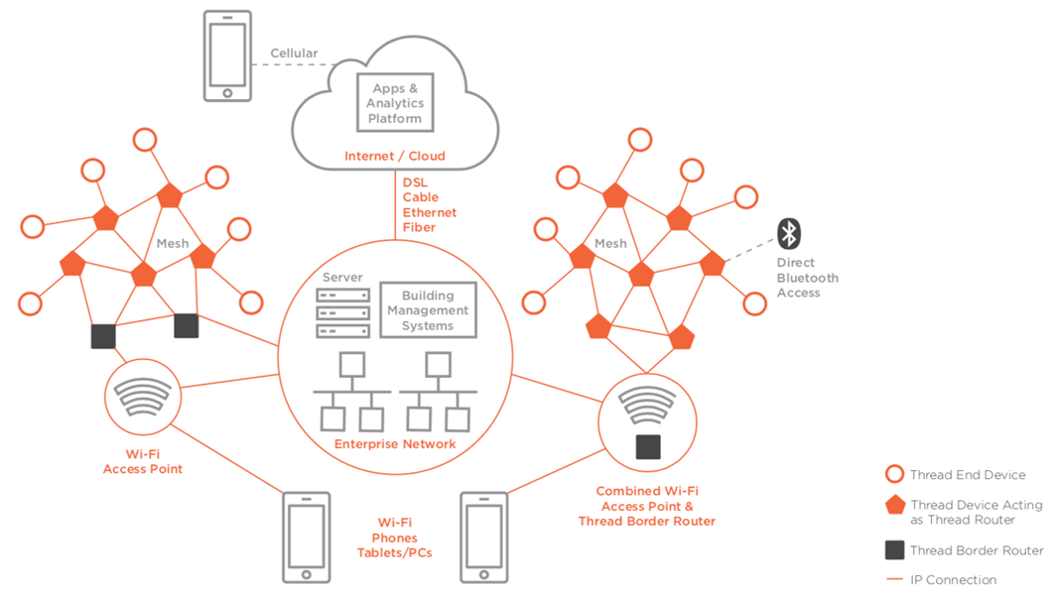
Thread Network Architecture

Slide 50
IEEE 802.15.4
Thread Applications
Being an IP-based open standard, Thread allows smart home devices to securely and reliably connect directly to the cloud.
Home automation using IoT devices such as lights, thermostats, door locks, and securing cameras

Slide 51
IEEE 802.15.4g and 802.15.4e
IEEE 802.15.4e amendment of 802.15.4-2011 expands the MAC layer feature set to remedy the disadvantages associated with 802.15.4, including MAC reliability, unbounded latency, and multipath fading
IEEE 802.15.4e-2012 enhanced the IEEE 802.15.4 MAC layer capabilities in the areas of frame format, security, determinism mechanism, and frequency hopping.
The IEEE continues to improve the 802.15.4 specification through amendments. For example, IEEE 802.15.4u defines the PHY layer characteristics for India (865–867 MHz). Meanwhile, IEEE 802.15.4v defines changes to the SUN PHYs, enabling the use of the 870–876 MHz and 915–921 MHz bands in Europe, the 902–928 MHz band in Mexico, the 902–907.5 MHz and 915–928 MHz bands in Brazil, the 915–928 MHz band in Australia/New Zealand, and Asian regional frequency bands that are not in IEEE 802.15.4-2015.

Slide 52
Standardization and Alliances
To guarantee interoperability, the Wi-SUN Alliance was formed. (SUN stands for smart utility network.
This organization is not a standards body but is instead an industry alliance that defines communication profiles for smart utility and related networks
These profiles are based on open standards, such as 802.15.4g-2012, 802.15.4e-2012, IPv6, 6LoWPAN, and UDP for the FAN profile

Slide 53
IEEE 802.15.4 (WI-SUN)
Security
The IEEE 802.15.4 specification uses Advanced Encryption Standard (AES) with 128-bit key length as the base encryption algorithm for securing its data.

Slide 54
Physical Layer
IEEE 802.15.4g-2012, the original IEEE 802.15.4 maximum PSDU or payload size of 127 bytes was increased for the SUN PHY to 2047 bytes
the default IPv6 MTU setting is 1280 bytes
Fragmentation is no longer necessary at Layer 2 when IPv6 packets are transmitted over IEEE 802.15.4g MAC frames
the error protection was improved in IEEE 802.15.4g by evolving the CRC from 16 to 32 bits
IEEE 802.15.4g-2012, supports multiple data rates in bands ranging from 169 MHz to 2.4 GHz

Slide 55
The main changes shown in the IEEE 802.15.4e header in Figure 4-9 are the presence of the Auxiliary Security Header and Information Element field. IE field contains one or more information elements that allow for additional information to be exchanged at the MAC layer.

Slide 56
MAC Layer IEEE 802.15.4 e
Time-Slotted Channel Hopping (TSCH): TSCH is an IEEE 802.15.4e-2012 MAC operation mode that works to guarantee media access and channel diversity. Channel hopping, also known as frequency hopping, utilizes different channels for transmission at different times. TSCH divides time into fixed time periods, or “time slots,” which offer guaranteed bandwidth and predictable latency. In a time slot, one packet and its acknowledgement can be transmitted, increasing network capacity because multiple nodes can communicate in the same time slot, using different channels. A number of time slots are defined as a “slot frame,” which is regularly repeated to provide “guaranteed access.” The transmitter and receiver agree on the channels and the timing for switching between channels through the combination of a global time slot counter and a global channel hopping sequence list, as computed on each node to determine the channel of each time slot.

Slide 57
MAC Layer IEEE 802.15.4 e
Information elements: Information elements (IEs) allow for the exchange of information at the MAC layer in an extensible manner, either as header IEs (standardized) and/or payload IEs (private). Specified in a tag, length, value (TLV) format, the IE field allows frames to carry additional metadata to support MAC layer services. These services may include IEEE 802.15.9 key management, Wi-SUN 1.0 IEs to broadcast and unicast schedule timing information, and frequency hopping synchronization information for the 6TiSCH architecture.
Enhanced beacons (EBs): EBs extend the flexibility of IEEE 802.15.4 beacons to allow the construction of application-specific beacon content. This is accomplished by including relevant IEs in EB frames. Some IEs that may be found in EBs include network metrics, frequency hopping broadcast schedule, and PAN information version.

Slide 58
Enhanced beacon requests (EBRs): Like enhanced beacons, an enhanced beacon request (EBRs) also leverages IEs. The IEs in EBRs allow the sender to selectively specify the request of information. Beacon responses are then limited to what was requested in the EBR. For example, a device can query for a PAN that is allowing new devices to join or a PAN that supports a certain set of MAC/PHY capabilities.
Enhanced Acknowledgement: The Enhanced Acknowledgement frame allows for the integration of a frame counter for the frame being acknowledged. This feature helps protect against certain attacks that occur when Acknowledgement frames are spoofed.

Slide 59
IEEE 1901.2a
IEEE 1901.2a-2013 is a wired technology that is an update to the original IEEE 1901.2 specification. This is a standard for Narrowband Power Line Communication (NB-PLC).
NB-PLC leverages a narrowband spectrum for low power, long range, and resistance to interference over the same wires that carry electric power
NB-PLC is often found in use cases such as the following:
Smart metering: NB-PLC can be used to automate the reading of utility meters, such as electric, gas, and water meters. This is true particularly in Europe, where PLC is the preferred technology for utilities deploying smart meter solutions.

Slide 60
IEEE 1901.2a
Distribution automation: NB-PLC can be used for distribution automation, which involves monitoring and controlling all the devices in the power grid.
Public lighting: A common use for NB-PLC is with public lighting—the lights found in cities and along streets, highways, and public areas such as parks.
Electric vehicle charging stations: NB-PLC can be used for electric vehicle charging stations, where the batteries of electric vehicles can be recharged.
Microgrids: NB-PLC can be used for microgrids, local energy grids that can disconnect from the traditional grid and operate independently.
Renewable energy: NB-PLC can be used in renewable energy applications, such as solar, wind power, hydroelectric, and geothermal heat.

Slide 61
IEEE 1901.2a- Physical Layer
CENELEC is the French Comité Européen de Normalisation Électrotechnique, which in English translates to
European Committee for Electrotechnical Standardization.

Slide 62
IEEE 1901.2a- MAC Layer
MAC frame format of IEEE 1901.2a is based on the IEEE 802.15.4 MAC frame but integrates the latest IEEE 802.15.4e-2012 amendment

Slide 63
As shown in Figure 4-12, IEEE 1901.2 has a Segment Control field. This is a new field that was not present in our previous discussions of the MAC frame for 802.15.4 and 802.15.4e. This field handles the segmentation or fragmentation of upper-layer packets with sizes larger than what can be carried in the MAC protocol data unit (MPDU).

Slide 64
Topology
Use cases and deployment topologies for IEEE 1901.2a are tied to the physical power lines. As with wireless technologies, signal propagation is limited by factors such as noise, interference, distortion, and attenuation. These factors become more prevalent with distance, so most NB-PLC deployments use some sort of mesh topology. Mesh networks offer the advantage of devices relaying the traffic of other devices so longer distances can be segmented. Figure 4-13 highlights a network scenario in which a PLC mesh network is applied to a neighborhood.

Slide 66
IEEE 1901.2a Security
IEEE 1901.2a security offers similar features to IEEE 802.15.4g. Encryption and authentication are performed using AES. In addition, IEEE 1901.2a aligns with 802.15.4g in its ability to support the IEEE 802.15.9 Key Management Protocol. However, some differences exist. These differences are mostly tied to the PHY layer fragmentation capabilities of IEEE 1901.2a and include the following:

Slide 67
IEEE 802.11ah
IEEE 802.11 Wi-Fi is certainly the most successfully deployed wireless technology
A key IoT wireless access technology, either for connecting endpoints such as fog computing nodes, high-data-rate sensors, and audio or video analytics devices or for deploying Wi-Fi backhaul infrastructures, such as outdoor Wi-Fi mesh in smart cities, oil and mining, or other environments
Wi-Fi lacks sub-GHz support for better signal penetration, low power for battery powered nodes, and the ability to support a large number of devices
For these reasons, the IEEE 802.11 working group launched a task group named IEEE 802.11ah to specify a sub-GHz version of Wi-Fi

Slide 68
IEEE 802.11 use cases
Sensors and meters covering a smart grid: Meter to pole, environmental/agricultural monitoring, industrial process sensors, indoor healthcare system and fitness sensors, home and building automation sensors
Backhaul aggregation of industrial sensors and meter data: Potentially connecting IEEE 802.15.4g subnetworks
Extended range Wi-Fi: For outdoor extended-range hotspot or cellular traffic offloading when distances already covered by IEEE 802.11a/b/g/n/ac are not good enough

Slide 69
Standardization and Alliances
In July 2010, the IEEE 802.11 working group decided to work on an “industrial Wi-Fi” and created the IEEE 802.11ah group. The 802.11ah specification would operate in unlicensed sub-GHz frequency bands, similar to IEEE 802.15.4 and other LPWA technologies.
For the 802.11ah standard, the Wi-Fi Alliance defined a new brand called Wi-Fi HaLow. This marketing name is based on a play on words between “11ah” in reverse and “low power.” It is similar to the word “hello” but it is pronounced “hay-low.”

Slide 70
IEEE 802.11ah Physical Layer
IEEE 802.11ah essentially provides an additional 802.11 physical layer operating in unlicensed sub-GHz bands. For example, various countries and regions use the following bands for IEEE 802.11ah: 868–868.6 MHz for EMEAR, 902–928 MHz and associated subsets for North America and Asia-Pacific regions, and 314–316 MHz, 430–434 MHz, 470–510 MHz, and 779–787 MHz for China.
Based on OFDM modulation, IEEE 802.11ah uses channels of 2, 4, 8, or 16 MHz (and also 1 MHz for low-bandwidth transmission).
data rate of 100 kbps, the outdoor transmission range for IEEE 802.11ah is expected to be 0.62 mile.

Slide 71
IEEE 802.11ah MAC Layer
The IEEE 802.11ah MAC layer is optimized to support the new sub-GHz Wi-Fi PHY while providing low power consumption and the ability to support a larger number of endpoints. Enhancements and features specified by IEEE 802.11ah for the MAC layer include the following:
Number of devices: Has been scaled up to 8192 per access point
MAC header: Has been shortened to allow more efficient communication.
Null data packet (NDP) support: Is extended to cover several control and management frames. Relevant information is concentrated in the PHY header, and the additional overhead associated with decoding the MAC header and data payload is avoided. This change makes the control frame exchanges efficient and less power consuming for the receiving stations.

Slide 72
Grouping and sectorization: Enables an AP to use sector antennas and also group stations (distributing a group ID). In combination with RAW and TWT, this mechanism reduces contention in large cells with many clients by restricting which group, in which sector, can contend during which time window
Restricted access window (RAW): Is a control algorithm that avoids simultaneous transmissions when many devices are present and provides fair access to the wireless network. By providing more efficient access to the medium, additional power savings for battery-powered devices can be achieved, and collisions are reduced.
Target wake time (TWT): Reduces energy consumption by permitting an access point to define times when a device can access the network. This allows devices to enter a low-power state until their TWT time arrives. It also reduces the probability of collisions in large cells with many clients.
Speed frame exchange: Enables an AP and endpoint to exchange frames during a reserved transmit opportunity (TXOP). This reduces contention on the medium, minimizes the number of frame exchanges to improve channel efficiency, and extends battery life by keeping awake times short.

Slide 73
Topology

Slide 74
Security
No additional security has been identified for IEEE 802.11ah compared to other IEEE 802.11 specifications

Slide 75
Long Range IoT Access Technologies-LPWA
In recent years, a new set of wireless technologies known as Low-Power Wide-Area (LPWA) has received a lot of attention from the industry and press
Well adapted for long-range and battery-powered endpoints
We will explore few examples of unlicensed-band LPWA technology such as
LoRa/LoRaWAN
NB-IoT

Slide 76
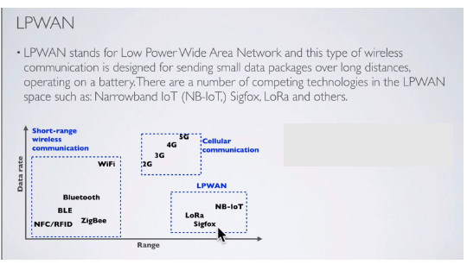

Slide 78
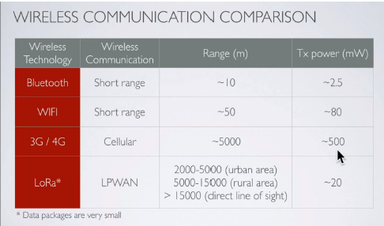

Slide 79
LoRa/LoRaWAN
Initially, LoRa was a physical layer, or Layer 1, modulation that was developed by a French company named Cycleo. Later, Cycleo was acquired by Semtech
Optimized for long-range, two-way communications and low power consumption, the technology evolved from Layer 1 to a broader scope through the creation of the LoRa Alliance
Semtech LoRa as a Layer 1 PHY modulation technology is available through multiple chipset vendors.
To differentiate from the physical layer modulation known as LoRa, the LoRa Alliance uses the term LoRaWAN to refer to its architecture and its specifications that describe end-to-end LoRaWAN communications and protocols

Slide 80
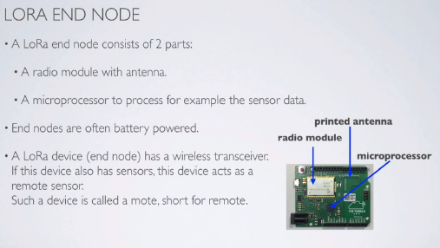

Slide 81
LoRa/LoRaWAN
Figure 4-15 provides a high-level overview of the LoRaWAN layers. In this figure, notice that Semtech is responsible for the PHY layer, while the LoRa Alliance handles the MAC layer and regional frequency bands.

Slide 82
Physical Layer
Semtech LoRa modulation is based on chirp spread spectrum modulation
it allows demodulation below the noise floor, offers robustness to noise and interference, and manages a single channel occupation by different spreading factors
This enables LoRa devices to receive on multiple channels in parallel.
LoRaWAN 1.0.2 regional specifications describe the use of the main unlicensed sub-GHz frequency bands of 433 MHz, 779–787 MHz, 863–870 MHz, and 902–928 MHz, as well as regional profiles for a subset of the 902–928 MHz bandwidth. For example, Australia utilizes 915–928 MHz frequency bands, while South Korea uses 920–923 MHz and Japan uses 920–928 MHz.
Recently, LoRaWAN introduced transceiver for 2.4 GHz

Slide 83
Understanding LoRa gateways is critical to understanding a LoRaWAN system. A LoRa gateway is deployed as the center hub of a star network architecture. It uses multiple transceivers and channels and can demodulate multiple channels at once or even demodulate multiple signals on the same channel simultaneously
LoRa gateways serve as a transparent bridge relaying data between endpoints, and the endpoints use a single-hop wireless connection to communicate with one or many gateways.
The data rate in LoRaWAN varies depending on the frequency bands and adaptive data rate (ADR).

Slide 84
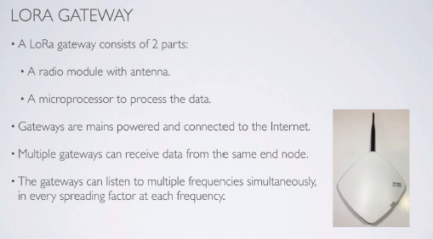

Slide 85
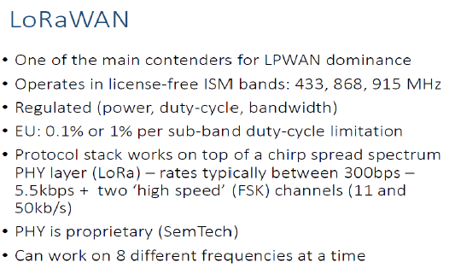

Slide 86
ADR is an algorithm that manages the data rate and radio signal for each endpoint.
ADR algorithm ensures that packets are delivered at the best data rate possible and that network performance is both optimal and scalable
Endpoints close to the gateways with good signal values transmit with the highest data rate, which enables a shorter transmission time over the wireless network, and the lowest transmit power
endpoints at the edge of the link budget communicate at the lowest data rate and highest transmit power

Slide 87
An important feature of LoRa is its ability to handle various data rates via the spreading factor
Devices with a low spreading factor (SF) achieve less distance in their communications but transmit at faster speeds, resulting in less airtime
A higher SF provides slower transmission rates but achieves a higher reliability at longer distances

Slide 89
Chirp Spread Spectrum Modulation
Besides the 3 basic modulation types there are many other modulation types.
LoRa is a proprietary spread spectrum modulation scheme that is based on Chirp Spread Spectrum modulation (CSS).
Chirp Spread Spectrum is a spread spectrum technique that uses wideband linear frequency modulated chirp pulses to encode information.
Spread spectrum techniques are methods by which a signal is deliberately spread in the frequency domain. For example a signal is transmitted in short bursts, "hopping" between frequencies in a pseudo random sequence.
A chirp, often called a sweep signal, is a tone in which the frequency increases (up-chirp) or decreases (down-chirp) with time. These chirp signals are used as carrier signals where a message is encoded on.

Slide 93
Another example, lets assume SF=12 Each symbol can carry 12 raw bits of information and there are 2^12 = 4096 unique chip values ranging from 0 to 4095.
The Spreading Factor (SF) defines two values: -The number of raw bits that can be encoded by that symbol: SF -Each symbol can hold 2^SF chips Please be aware of the difference between a chirp and a chip.
A symbol holds 2^SF chips.
Chirps are simply a ramp from flow to fhigh(up-chirp) or fhigh to flow (down-chirp).

Slide 95
To calculate the data rate (DR) or bit rate (Rb):
Rb(bits/sec) = SF x (BW / 2^SF) x (4/(4+CR))
Bandwidth (BW) in Hz
Spreading Factor (SF): 7-12
Code Rate (CR): 1-4
Because Rc= BW , the chip duration is calculated as follow:
Tc (sec) = 1 / BW
Bandwidth (BW) in Hz
For example: BW=125 kHz
Tc = 1 / 125000 = 8 µs
The symbol duration or sweep time is calculated as follow:
Ts(sec) = 2^SF / BW [1]

Slide 96
For example: SF=7, CR=1
BW=125 kHz, Rb= 7 x (125000 / 2^7) x (4 / (4 + 1)) = 5.5 kbits/s
BW=250 kHz, Rb= 7 x (250000 / 2^7) x (4 / (4 + 1)) = 10.9 kbits/s
BW=500 kHz, Rb= 7 x (500000 / 2^7) x (4 / (4 + 1)) = 21.9 kbits/s
If you increase the bandwidth, the bit rate or data rate is increased.

Slide 97
For example: BW=125 kHz, CR=1
SF=7, Rb= 7 x (125000/2^7 ) x (4/(4+1)) = 5.5 kbits/s
SF=8, Rb= 8 x (125000/2^8 ) x (4/(4+1)) = 3.13 kbits/s
SF=9, Rb= 9 x (125000/2^9 ) x (4/(4+1)) = 1.76 kbits/s
SF=10, Rb= 10 x (125000/2^10) x (4/(4+1)) = 0.98 kbits/s
SF=11, Rb= 11 x (125000/2^11) x (4/(4+1)) = 0.54 kbits/s
SF=12, Rb= 12 x (125000/2^12) x (4/(4+1)) = 0.29 kbits/s
If you increase the Spreading Factor, the bit rate or data rate is decreased.

Slide 99
For example: SF7
BW=125 kHz, Ts = 2^7 / 125000 = 1.024 ms
BW=250 kHz, Ts = 2^7 / 250000 = 512 µs
BW=500 kHz, Ts = 2^7 / 500000 = 256 µs
If the BW increases, the Symbol duration decreases.
For example: BW=125 kHz
SF=7, Ts = 2^7 / 125000 = 1.024 ms
SF=9, Ts = 2^9 / 125000 = 4.096 ms
SF=12, Ts = 2^12 / 125000 = 32.768 ms
If the SF increases, the Symbol duration increases.

Slide 100
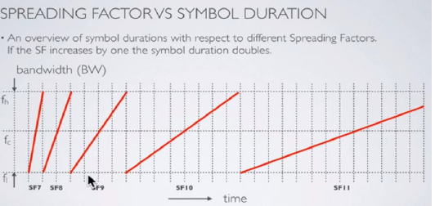

Slide 101
If you increase the SF by 1:
The symbol duration or sweep time doubles compared to the previous SF.
It reduces the bit rate approximately by half compared to the previous SF.
The Time on Air (ToA) (=message transmission time) increases which means the distance increases.
To give you an idea what the Time on Air is for a 10 byte payload and BW=125kHz:
SF7, transmission time = 41 ms
SF12, transmission time = 991 ms
LoRa devices uses a higher spreading factor when the signal is weak or there is lot of interference.
Using a higher spreading factor means a longer Time on Air (ToA).
If an end device is further away from a gateway the signal get weaker and therefore needs a higher spreading facto

Slide 102
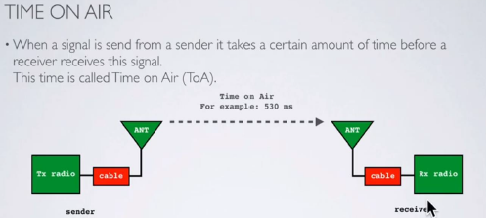

Slide 103
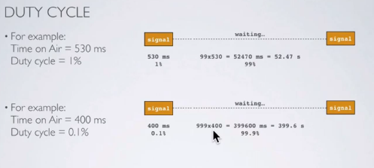

Slide 104
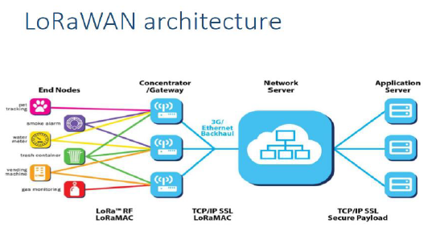

Slide 105
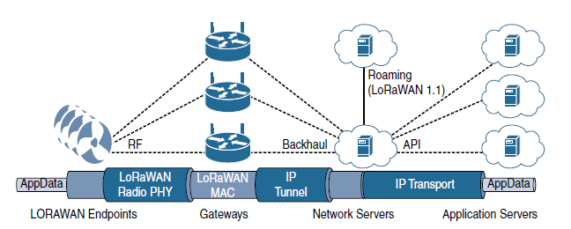
Figure 4-17 LoRaWAN Architecture

Slide 106
MAC Layer
MAC layer is defined in the LoRaWAN specification
This layer takes advantage of the LoRa physical layer and classifies LoRaWAN endpoints to optimize their battery life and ensure downstream communications to the LoRaWAN endpoints.
The LoRaWAN specification documents three classes of LoRaWAN devices:
Class A: This class is the default implementation. Optimized for battery-powered nodes, it allows bidirectional communications, where a given node is able to receive downstream traffic after transmitting. Two receive windows are available after each transmission.

Slide 107
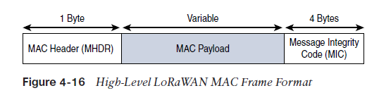
MAC Layer
Class B: This class was designated “experimental” in LoRaWAN 1.0.1 until it can be better defined. A Class B node or endpoint should get additional receive windows compared to Class A, but gateways must be synchronized through a beaconing process.
Class C: This class is particularly adapted for powered nodes. This classification enables a node to be continuously listening by keeping its receive window open when not transmitting
LoRaWAN messages, either uplink or downlink, have a PHY payload composed of a 1-byte MAC header, a variable-byte MAC payload, and a MIC that is 4 bytes in length. The MAC payload size depends on the frequency band and the data rate, ranging from 59 to 230 bytes for the 863–870 MHz band and 19 to 250 bytes for the 902–928 MHz band. Figure 4-16 shows a high-level LoRaWAN MAC frame format

Slide 111
LoRaWAN endpoints are uniquely addressable through a variety of methods, including the following:
An endpoint can have a global end device ID or DevEUI represented as an IEEE EUI-64 address.
An endpoint can have a global application ID or AppEUI represented as an IEEE EUI-64 address that uniquely identifies the application provider, such as the owner, of the end device.
In a LoRaWAN network, endpoints are also known by their end device address, known as a DevAddr, a 32-bit address. The 7 most significant bits are the network identifier (NwkID), which identifies the LoRaWAN network. The 25 least significant bits are used as the network address (NwkAddr) to identify the endpoint in the network.

Slide 112
Device Activation
LoRaWAN endpoints attached to a LoRaWAN network must get registered and authenticated. This can be achieved through one of the two join mechanisms:
Activation by personalization (ABP): Endpoints don’t need to run a join procedure as their individual details, including DevAddr and the NwkSKey and AppSKey session keys, are preconfigured and stored in the end device. This same information is registered in the LoRaWAN network server.
Over-the-air activation (OTAA): Endpoints are allowed to dynamically join a particular LoRaWAN network after successfully going through a join procedure. The join procedure must be done every time a session context is renewed. During the join process, which involves the sending and receiving of MAC layer join request and join accept messages, the node establishes its credentials with a LoRaWAN network server, exchanging its globally unique DevEUI, AppEUI, and AppKey. The AppKey is then used to derive the session NwkSKey and AppSKey keys.

Slide 114
NB-IoT and Other LTE Variations
Existing cellular technologies, such as GPRS, Edge, 3G, and 4G/LTE, are not particularly well adapted to battery-powered devices and small objects specifically developed for then Internet of Things
While industry players have been developing unlicensed-band LPWA technologies, 3rd Generation Partnership Project (3GPP) and associated vendors have been working on evolving cellular technologies to better address IoT requirements
The aim was to both align with specific IoT requirements, such as low throughput and low power consumption, and decrease the complexity and cost of the LTE devices
NB-IoT specifically addresses the requirements of a massive number of low-throughput devices, low device power consumption, improved indoor coverage, and optimized network architecture

Slide 115
NB-IoT
Definition of new Long-Term Evolution (LTE) device categories was not sufficient to support LPWA IoT requirement, 3GPP specified Narrowband IoT (NB-IoT)
Three modes of operation are applicable to NB-IoT:
Standalone: A GSM carrier is used as an NB-IoT carrier, enabling reuse of 900 MHz or 1800 MHz.
In-band: Part of an LTE carrier frequency band is allocated for use as an NB-IoT frequency. The service provider typically makes this allocation, and IoT devices are configured accordingly. You should be aware that if these devices must be deployed across different countries or regions using a different service provider, problems may occur unless there is some coordination between the service providers, and the NB-IoT frequency band allocations are the same.
Guard band: An NB-IoT carrier is between the LTE or Wideband Code Division Multiple Access (WCDMA) bands. This requires coexistence between LTE and NB-IoT bands

Slide 116
NB-IoT
Mobile service providers consider NB-IoT the target technology as it allows them to leverage their licensed spectrum to support LPWA use cases
NB-IoT is defined for a 200-kHz-wide channel in both uplink and downlink, allowing mobile service providers to optimize their spectrum, with a number of deployment options for GSM, WCDMA, and LTE spectrum, as shown in Figure 4-19.

Slide 118
In an LTE network, resource blocks are defined with an effective bandwidth of 180 kHz, while on NB-IoT, tone or subcarriers replace the LTE resource blocks
The uplink channel can be 15 kHz or 3.75 kHz or multi-tone (n*15 kHz, n up to 12)
NB-IoT operates in half-duplex frequency-division duplexing (FDD) mode with a maximum data rate uplink of 60 kbps and downlink of 30 kbps

Slide 119
Topology
NB-IoT is defined with a link budget of 164 dB; compare this with the GPRS link budget of 144 dB, used by many machine-to-machine services. The additional 20 dB link budget increase should guarantee better signal penetration in buildings and basements while achieving battery life requirements.

